Slide 1
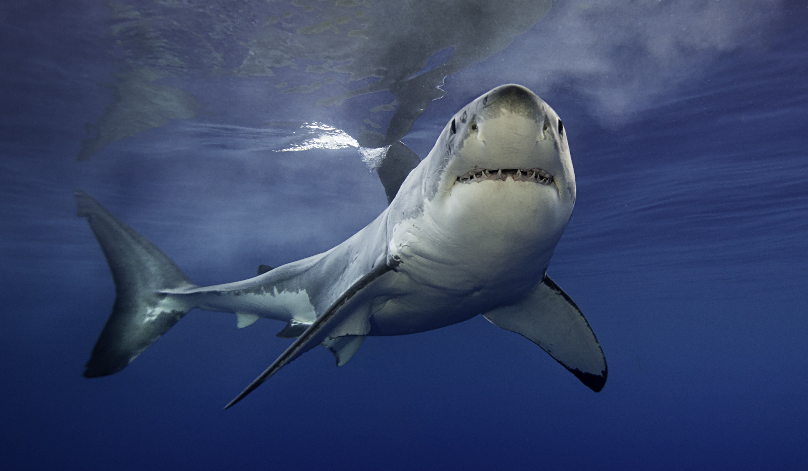
Shark Tank
tv show analysis
how to make a splash
Notes:
Show Overview.
Entrepreneurs pitch products to a group of potential investors they call Sharks. The pitch normally begins with an amount asked for a percentage of company ownership. Sharks can counter, join together, or drop out for any reason. For 15 seasons, with the last premiering on 9/29/2023, Shark Tank airs on over 8 networks, some of which are ABC, You Tube, hulu, and Amazon Prime. Welcome to the Tank.

Slide 2

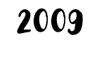
YEAR SEASON 1 DEBUTED IN U.S.
NOW AIRING ON OVER 8 NETWORKS
# OF SEASONS TO DATE.
LAST SEASON TO AIR CONCLUDED ON 05/03/2024 WITH 22 EPISODES
NEXT SEASON IN PRODUCTION
RUMORED TO BE MARK CUBAN’S LAST
DON’T TOUCH THAT DIAL!
15
16
Notes:
Get to know the show.

Slide 3

Who left with a Shark DEAL
and
who got BEACHED?
Notes:
How Many Pitches Result in Deals? Deal Success Rate: We conducted an analysis of 1361 pitches over fifteen seasons of the television show "Shark Tank." Throughout the fifteen seasons, entrepreneurs presented 1361 business proposals to the sharks in the hope of making a deal. Out of these pitches, 824 deals were made, which means around 60.5% of the pitches resulted in deals. This suggests a competitive environment where successful pitches have an advantage.

Slide 4

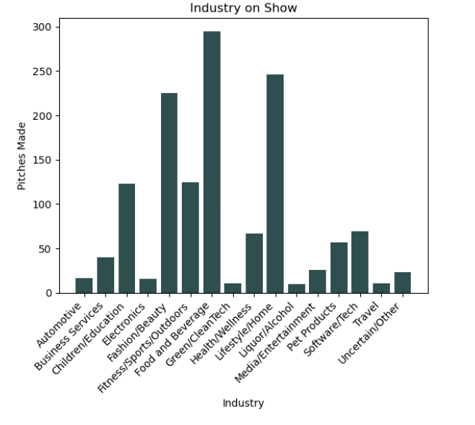
Which industry appears most ?
Notes:
Top Industries: The industries most frequently featured on the show include Food and Beverage, Lifestyle/Home, and Fashion/Beauty, suggesting these sectors attract investor interest.

Slide 5


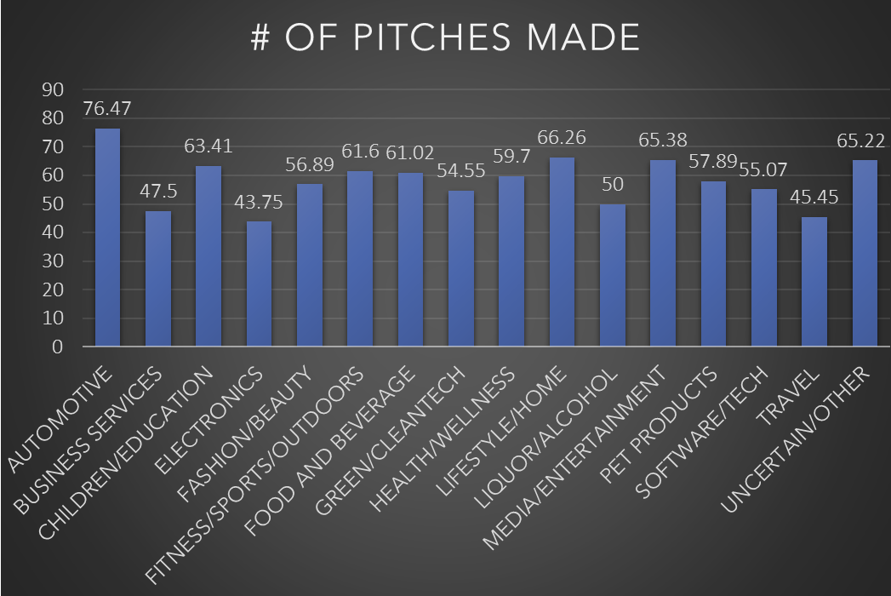



INDUSTRY EVALUATION
WHICH SHARKBAIT
DID THEY CHOOSE?
Notes:
Which industries receive the most deals? What industries appear most frequently on the show? Top Industries: The industries most frequently featured on the show include Food and Beverage, Lifestyle/Home, and Fashion/Beauty, suggesting these sectors attract investor interest.
Top Deals by Industry: In line with the pitches, the top three industries that secured deals on the show are Food and Beverage, Lifestyle/Home, and Fashion/Beauty.

Slide 6

Notes:
How many sharks invest in each deal? Solo or Multiple Shark Deals: Not all deals are funded by individual investors. This chart shows the number of investors participating in each deal. Solo investors are a clear favorite. The majority, 73.5%, of deals analyzed were secured by sole investors/sharks.

Slide 7
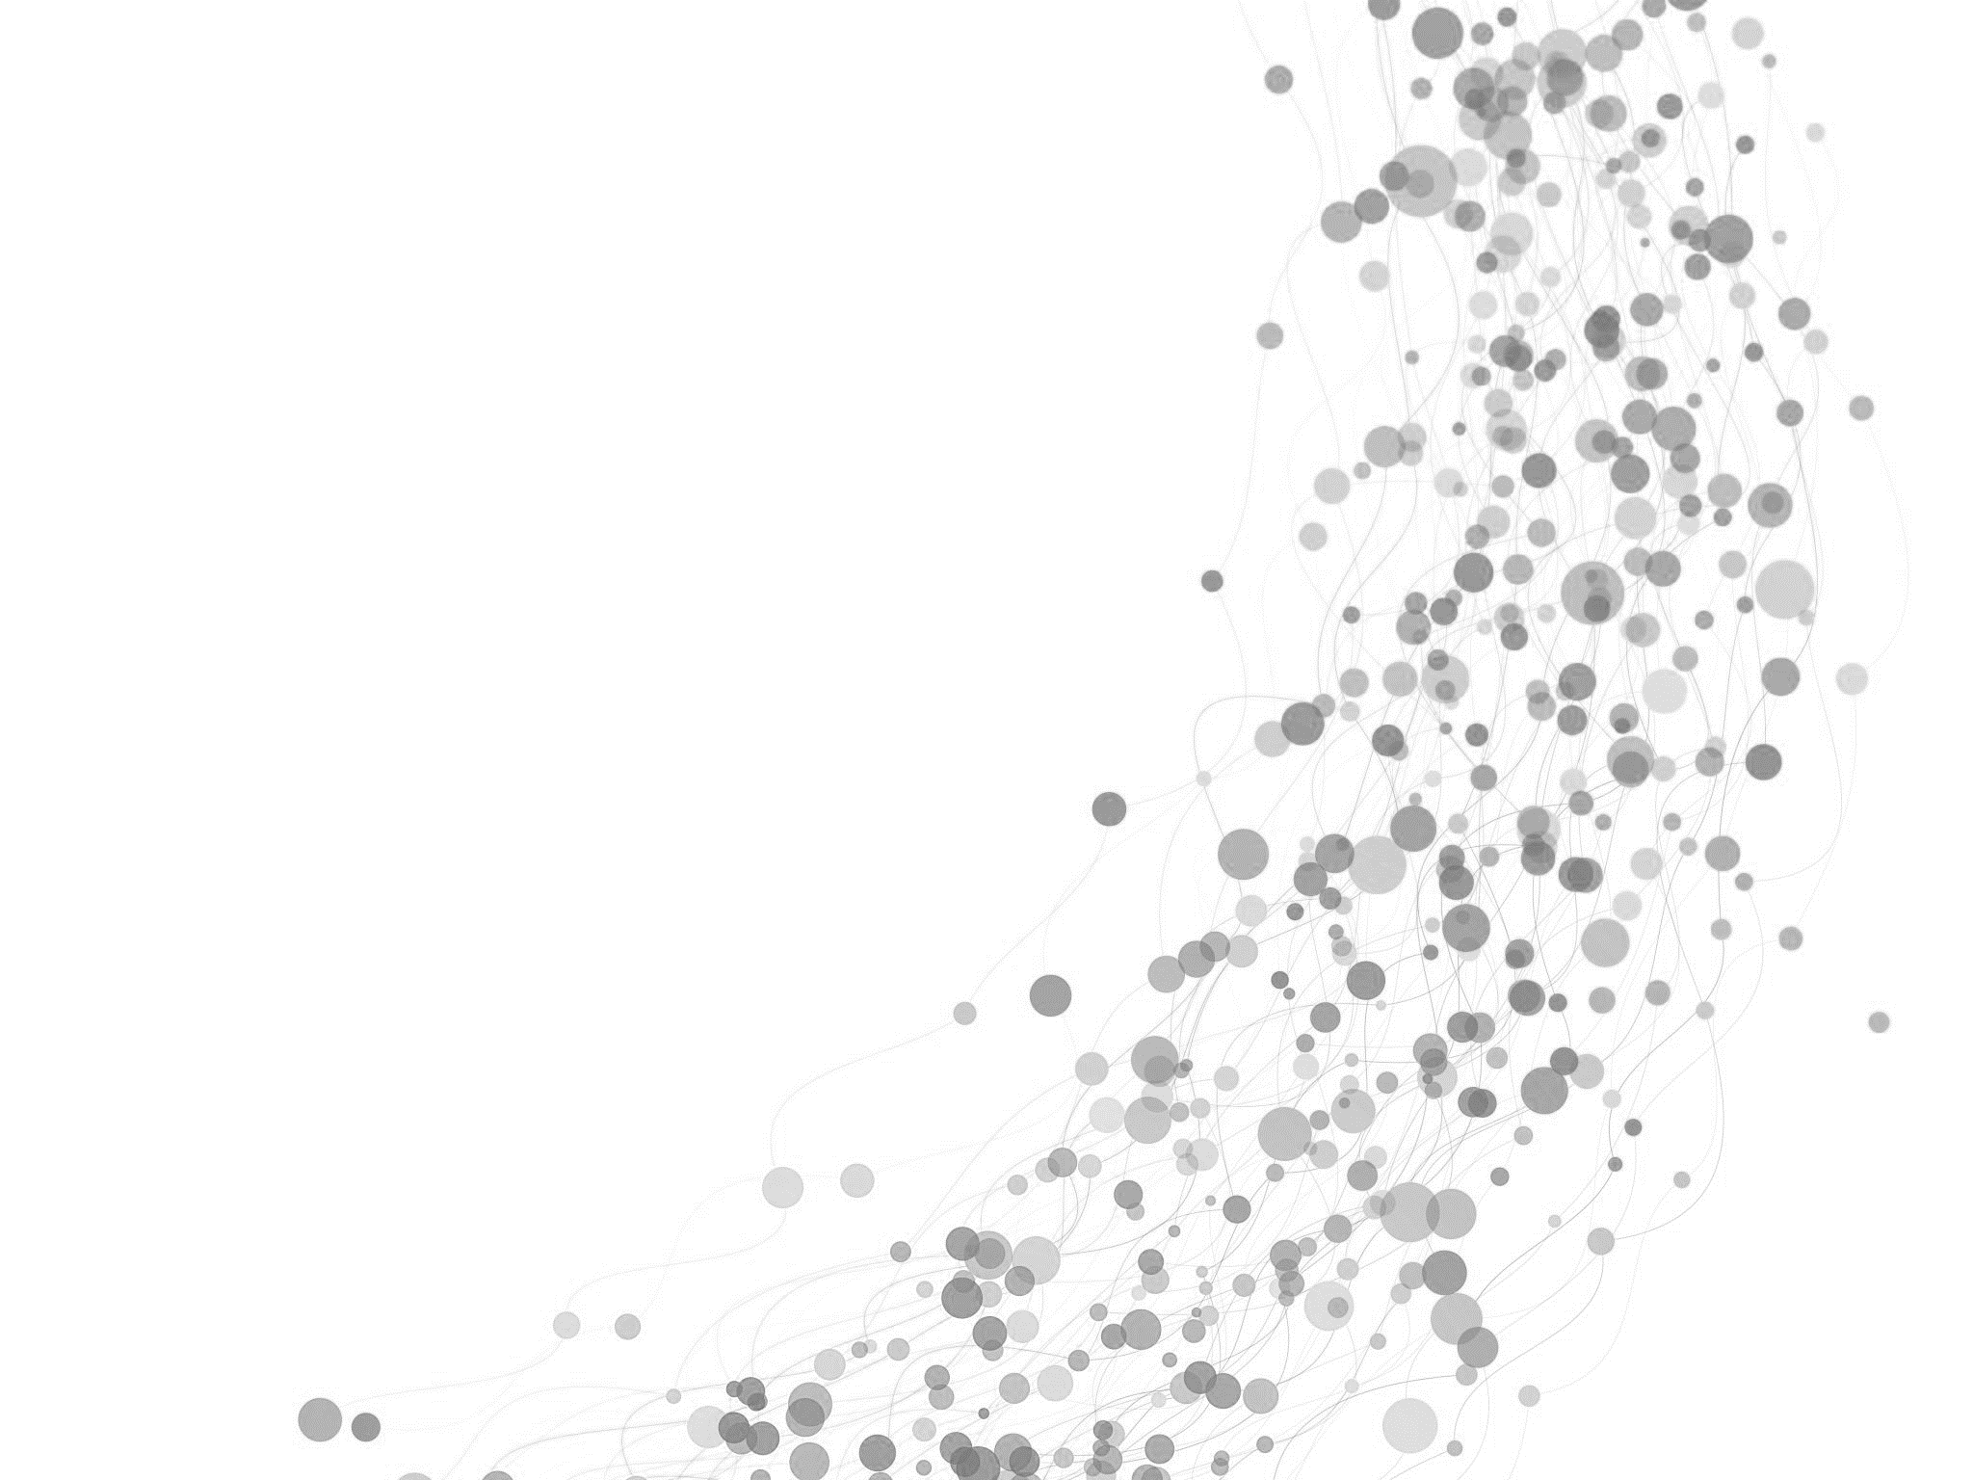
What a Catch! Which Shark REELS in the most DEALS?
MARK CUBAN
249
KEVIN O’LEARY 127
DAYMOND JOHN
117
ROBERT HERJAVEC 127
LORI GREINER 217
BARBARA COCORAN 130
Notes:
Which shark makes the most deals? Top Shark: The shark who makes the most deals is billionaire, Mark Cuban. He leads the group with 249 secured deals.

Slide 8

Notes:
Who does Mark partner with?
Top Shark Collaborators: Part of Mark’s success can be attributed to his tendency to pair up with his counterparts to secure a deal. Mark has partnered with every other shark to make a deal. Lori Greiner is clearly his preferred partner, accounting for 39.2% of Mark’s joint deals.

Slide 9
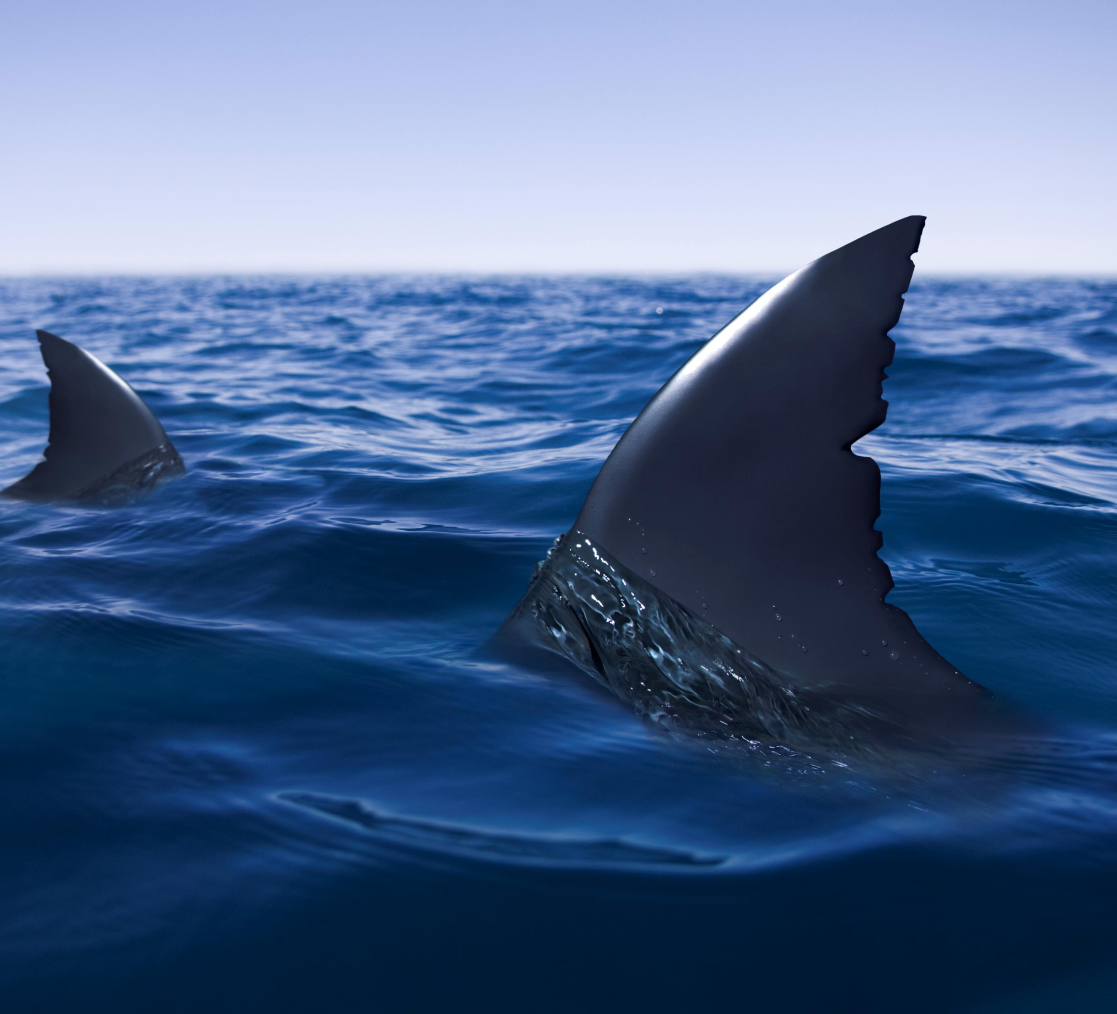
MARK & LORI TOP INDUSTRIES WHEN PARTNERED
FOOD / BEVERAGE
LIFESTYLE / HOME
BEAUTY /
FASHION
Notes:
With Lori by his side, which industries do they invest in the most? Mark and Lori Top Industry Selection: Mark and Lori invest in the Lifestyle/Home industry the most. They have made 16 deals in the Lifestyle/Home sector of the industry.

Slide 10

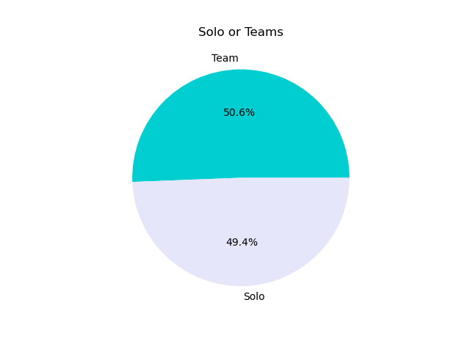
Ride solo, or bring in the school? Your odds of hooking a deal…
Notes:
Solo or Team Pitcher: In this graph we conducted an analysis to see the percentage of who receives a deal on Shark Tank based on rather the pitchers were solo or on a team. We see that if the pitchers decided to be solo or on a team there is an equal chance for a deal for both choices. There is no significant difference between solo and teams, so we suggest choosing whichever option is most comfortable!

Slide 11
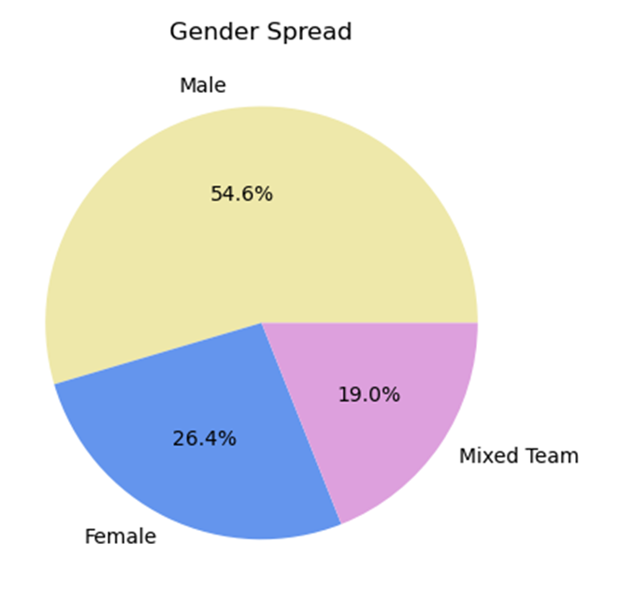

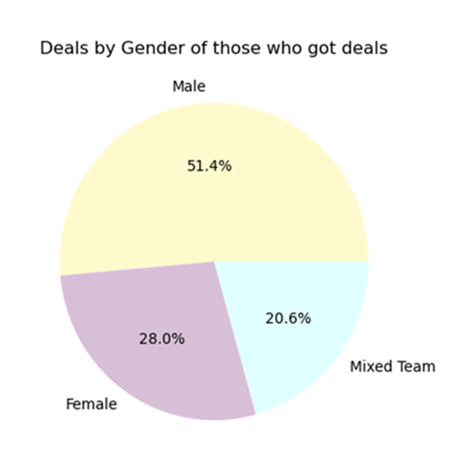

Which gender is most successful?
Which gender is most represented?
Notes:
What percentage of each group receives a deal? Deals By Gender: After finding the percentage of entrepreneurs who appear on Shark Tank, we conducted an analysis to see who actually receives a deal based on gender. In this graph we see that male pitchers make up over half of the pitchers who received a deal with 51.4%. Next, we see that female pitchers make up 28.0% of pitchers who received a deal. Finally, we see that teams made up of both male and female groups make up 20.6% of all successful Shark Tank pitchers. While this graph shows us the total numbers of pitchers who successfully made a deal based on gender, it is not representative of which group of pitchers are statistically more successful at receiving a deal.
What gender is represented the most in Shark Tank? Gender Representation: In this graph we conducted an analysis of the three different types of groups of pitchers who have appeared on Shark Tank based on gender. These three groups are solo groups of male pitchers, female pitchers, and teams with both male and female pitchers. Making up more than half of the total pitchers, this graph shows us that the gender who appears the most on Shark Tank is male at 54.6%. The second most represented group is solo female entrepreneurs at 26.4%. The least represented group is the team groups that are made up of both male and female pitchers at 19.0%

Slide 12

Gender Success Rate
FEMALES 358 PITCHED,
229 DEALS MADE
MALES 739 PITCHED,
421 DEALS MADE
Notes:
What gender has the highest success rate? Gender Success Rate: This graph represents the overall success rate of male pitchers and female pitchers. When looking at the data we see that out of 739 solo male pitchers only 421 were successful in receiving a deal. Alternatively, out of 358 solo female pitchers only 229 solo female pitchers were successful at receiving a deal. Overall, 56.97% of solo male pitchers were successful at receiving a deal while 63.97% of solo female pitchers were successful at receiving a deal. According to the data, solo female pitchers are more successful in receiving a deal.

Slide 13

Speaking impact – Give Back
THEY DON’T JUST BITE, THEY GIVE BACK…
Our catch and release:
Bombas Socks donate one pair for each pair sold
(#1 most requested item in homeless shelters)
OVER 100 MILLION PAIRS DONATED, AND STILL COUNTING…
https://shop.bombas.com/

